Slide 1
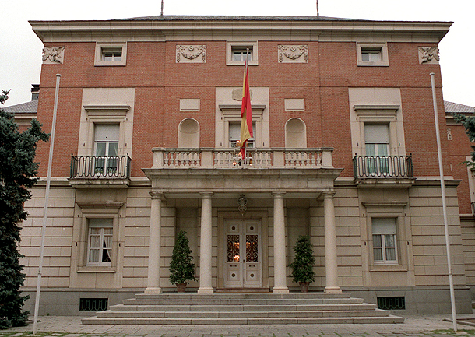
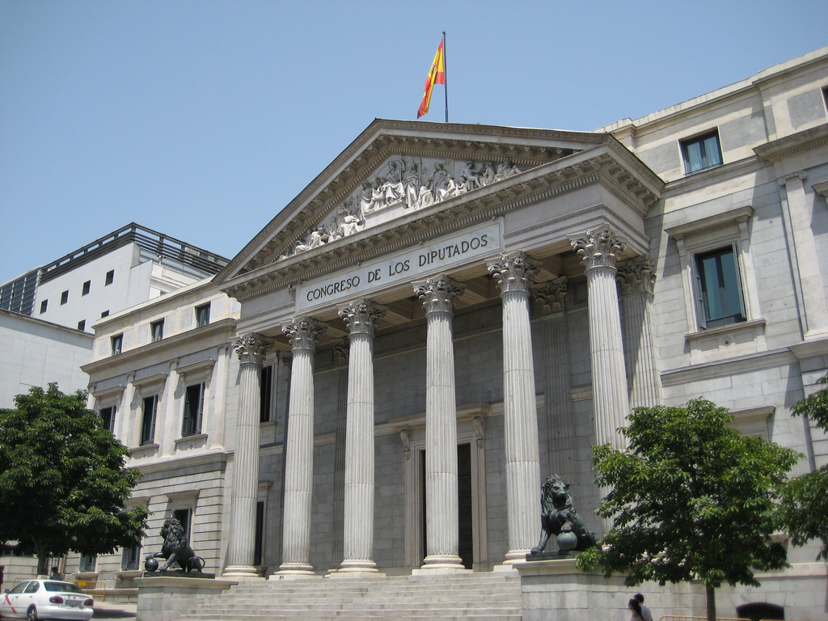
SPANISH GOVERNMENT
Executive Branch
Legislative Branch
Judicial Branch

